Slide 1
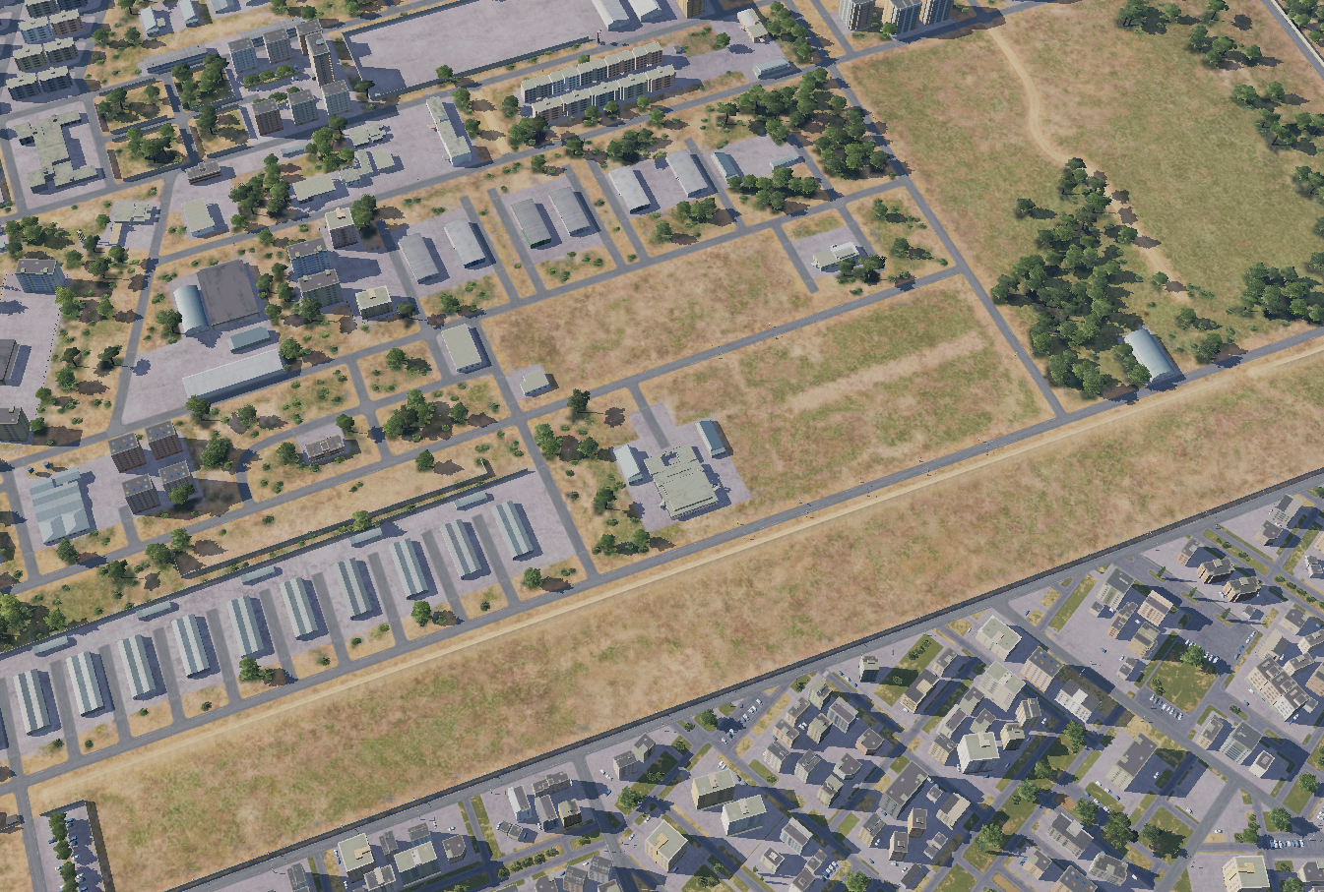

OPARTGT002, Syrian Army HQ building 2
INSERT PICTURE HERE
MAP / WHERE THE TGT IS LOCATED
HQ building
N
2
OPARTGT001
1
1
Weaponeering
DPI 1: N36 10.755 E037 05.895/1427, 1 x 1000Ibs bomb. It is a concrete building, 2 stories high with a reinforced roof, surrounded by 2 metal sheet buildings believed to be storage areas.
Collaterdal Damage Concern (CDC)
CDC 1, Civilian buildings, CDE 4, 160m SSE from DPI 1
3
4
5
6
CDC 1, Civilian housings
7
8

Slide 2
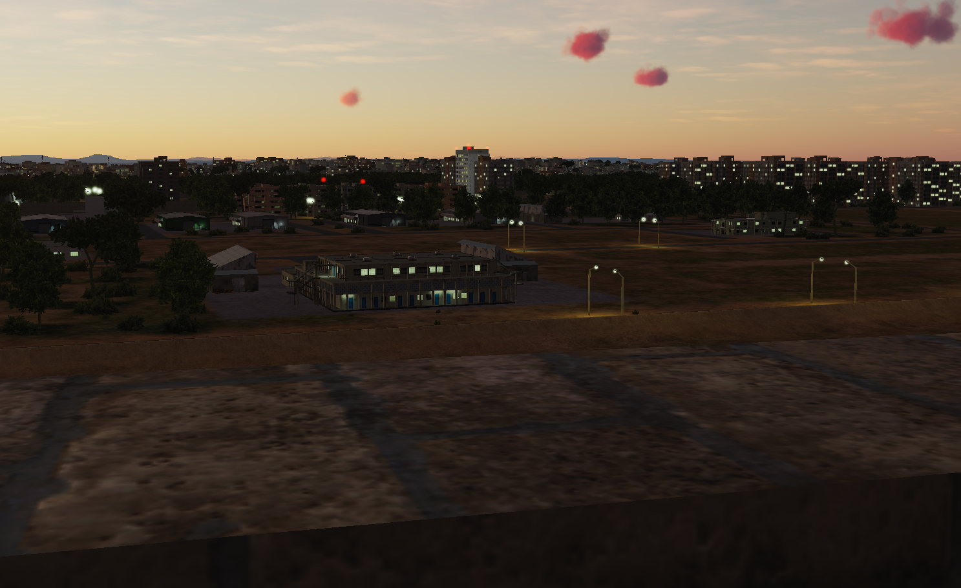
OPARTGT001, Syrian Army HQ building 1, HUMINT
N
N
DPI 1
1
1
2
3
4
5
6
7
8

